Slide 1
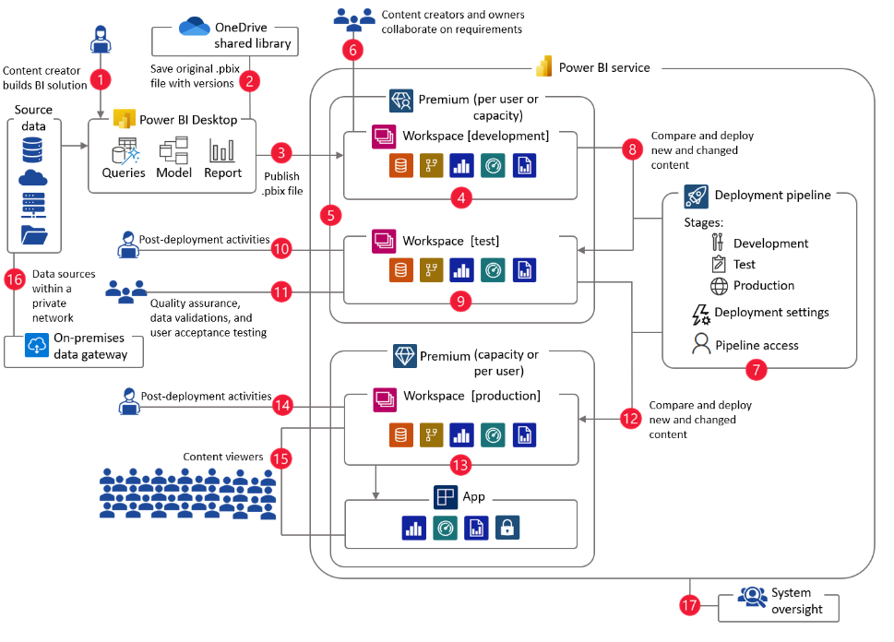
01: Enterprise Data & Analytics Engineering
Enhance collaboration and manage content at scale and across your entire data estate with Azure DevOps
Self-Service Architecture

Slide 2
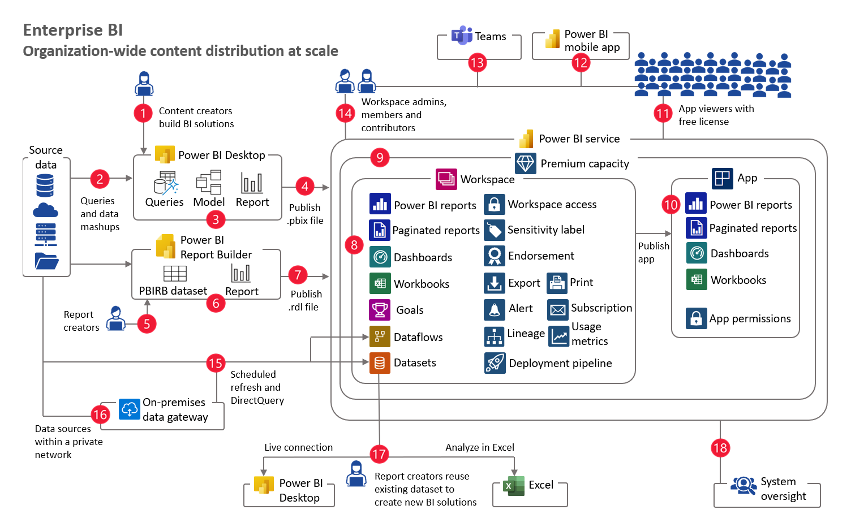
01: Enterprise Data & Analytics Engineering
Enhance collaboration and manage content at scale and across your entire data estate with Azure DevOps
Enterprise Architecture

Slide 3
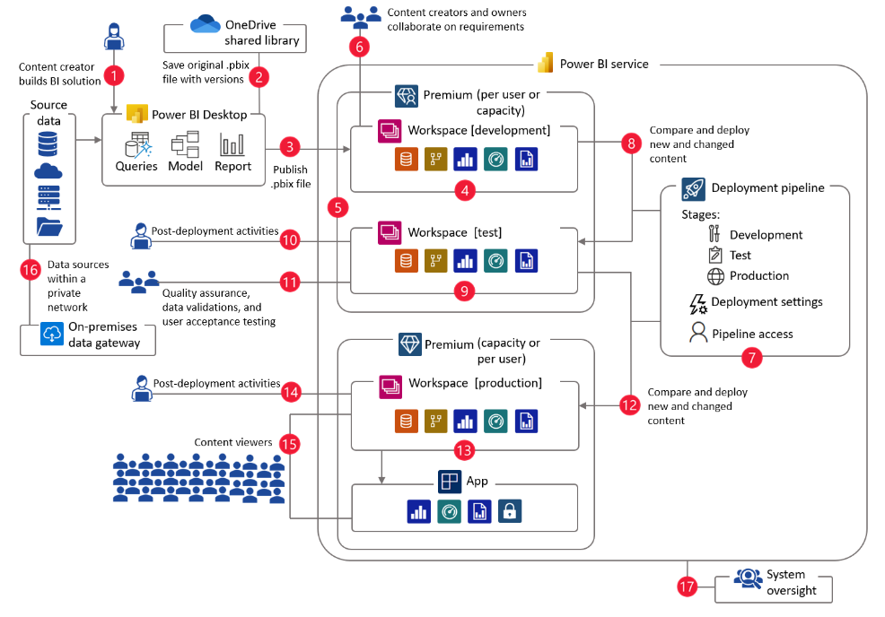
02: Enterprise Data & Analytics Engineering – Self Service – Deployment Pipelines Architecture
Enterprise Architecture
Deployment Pipelines Architecture

Slide 4
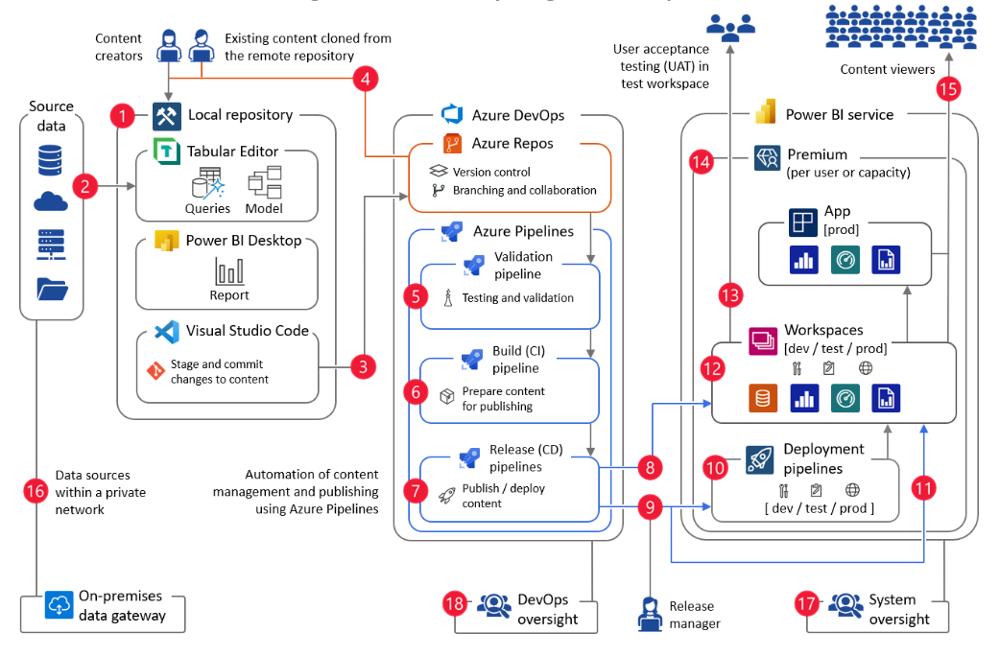
03: Enterprise Data & Analytics Engineering – Power BI with Azure DevOps Architecture
Enhance collaboration and manage content at scale and across your entire data estate with Azure DevOps
Enterprise Architecture
Power BI with
Azure DevOps

Slide 5
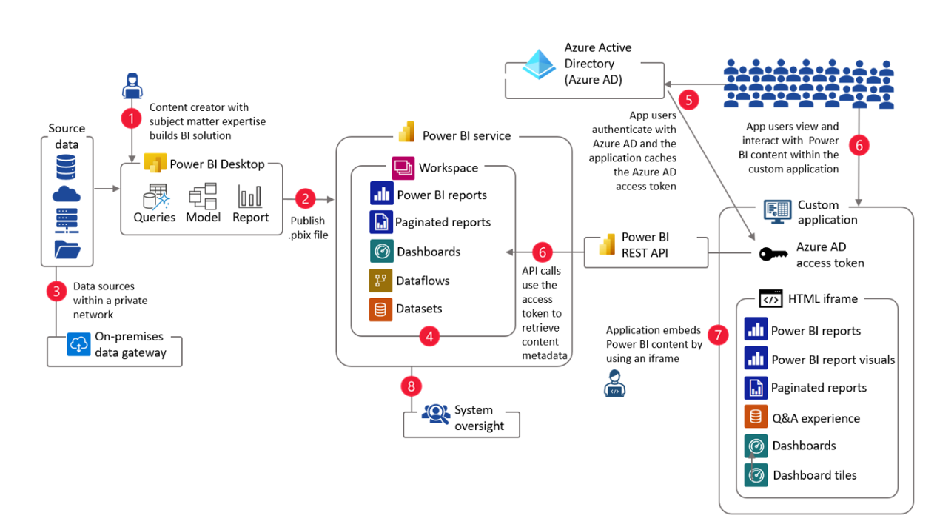
04: Enterprise Data & Analytics Engineering – Power BI Embedded for your organizational Architecture
Enhance collaboration and manage content at scale and across your entire data estate with Azure DevOps
Enterprise Architecture
Internal - Power BI Embedded

Slide 6
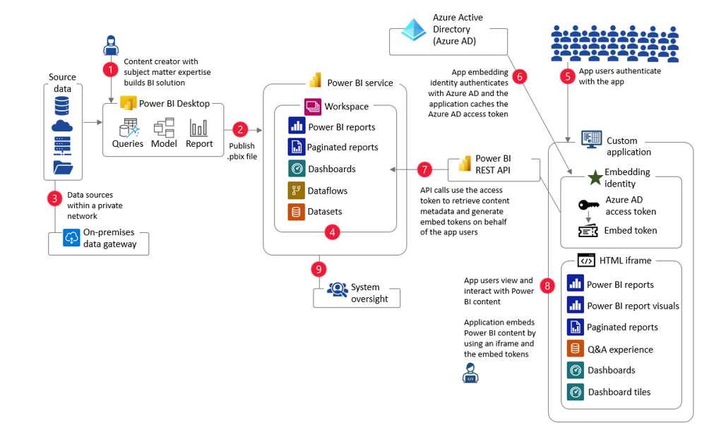
04: Enterprise Data & Analytics Engineering – Power BI Embedded for your Customers Architecture
Enhance collaboration and manage content at scale and across your entire data estate with Azure DevOps
Enterprise Architecture
External - Power BI Embedded

Slide 7



















05: Enterprise Data & Analytics Engineering -
Enhance collaboration and manage content at scale and across your entire data estate with Azure DevOps
Lakehouse Medallion Architecture
Power BI service
Source data
Bronze
2
Silver
3
Gold
4
Dataset Workspaces
Content Workspaces
8
9
ADLSg2 - Dev
ADLSg2 - Dev
ADLSg2 - Dev
Dev
Dev
Source Folders
Domain Folders
Domain Modeled Folders
1
ADLSg2 - Test
5
ADLSg2 - Test
6
ADLSg2 - Test
7
Test
Test
Source Folders
Domain Folders
Domain Modeled Folders
ADLSg2 - Prod
ADLSg2 - Prod
ADLSg2 - Prod
Prod
Prod
Source Folders
Domain Folders
Domain Modeled Folders
10
Data sources with private network
15
16
17
Azure DevOps
Azure Repos
Azure Pipelines
Validation Pipeline
Build (CI) pipeline
Release (CD) pipeline
On-premises data gateway
11
Version Control
12
13
Prepare content for publishing
14
Branching and collaboration
Testing and validation
Publish / deploy content
Data Teams
Data Engineer
Analytics Engineer
Content Creator
18
19
20
Tabular Editor
21
Power BI Desktop
Visual Studio Code
Paginated report builder
Shrikesh Pattni

